Slide 1


The All in One Software Application for Insurance Management

Slide 2
About tigerlab
2008: tigerlab Company registration in Malaysia in the Business area of web based IT Solutions for GE.
2013: tigerlab became selected IT partner of AOK Systems to built the Online Business Portal, which provided to more than 25 Millions Customers of AOK Deutschland.
2014: tigerlab started the development of an Insurance software for General Insurance Products
2015: tigerlab rolled out their first version of tigerlab’s “A1 INSURANCE - Business Suite” to Hannover RE (Asia) clients to provide them a Software, which is based on the latest Insurance Industry trends
2017: Company registration (subsidiary) in UK (London)
Q1/2018: Company Registration (subsidiary) - Service Team in Latvia (Riga)
Q1/2018: Company registration (subsidiary) – Sales and Service Team in Argentina (Buenos Aires)

Slide 3
About tigerlab A1 INSURANCE - Software
Web-based ALL in ONE (A1) INSURANCE Business Suite for Insurance Companies, Underwriting Agencies, Brokers, Banks and other Intermediaries.
Powerful Quote and Sales Module including a flexible Rating Engine for all Insurance Products. (e.g. Motor, Travel, PA, Fire, others)
Comprehensive, User friendly Customer Service Portal to serve your Clients better
Various API’s to integrate any 3rd Party Software for adding additional process or client value.
Innovative mobile Claim-on-the-Spot Module, which significantly reduce fraudulent Claims
Strong Workflow Modeler to optimize Clients Business Processes
Extensive CRM Features to support the customer Journey (Marketing – Sales – Service) within one system.
Future proof - Built on a cutting-edge technology (Python). It will be continuously updated and follows the latest InsureTech trends
White Label out of the box Solution with “Plug & Play” capabilities (quick go to Market).

Slide 4





tigerlab’s Unique Selling Propositions (USP)
PRICING MODEL
ROLL-OUT SPEED
CUSTOMIZABILITY
FUTURE-PROOF
INDUSTRY SOLUTION
No upfront costs, no financial risk for clients
Period between project sign-off and go-live typically is only a few weeks
All client requirements can be 100 % configured or implemented
Built on the latest technical platform. It will be continuously updated and follows the latest InsureTech trends
Experience in servicing clients worldwide, brings new ideas and improves processes and client sales results

Slide 5


Value Proposition
Ability to add new products for up- and cross-selling
Add new sales channels (B2B2C, B2C, etc.)
Limited/No up-front costs (only client specific customization)
No maintenance fee
Regular upgrades free of charge
Increasing Revenue
Low TCO
Python – Modern and Reliable Technology
Security, Firewalls, Backups, Encryption
Python is also used by Google, Dropbox, YouTube and many more
Subscription model (pay-as-you use)
Termination anytime (data will be handed back)
Low Risk
Latest Technology

Slide 6











tigerlab INSURANCE - Business Suite
Web
Mobile
Telephone
Partner Channel Management
3RD PARTY
ACCESS LEVEL
Application Permission Control
Customers
Insurers
Intermediaries
Partners
3rd Parties
Marketing Channel
Sales & Quote Module
Customer Self Service Portal
(mobile) Claim Submission Module
API
or
File
Upload
Business Intelligence
CLIENT SERVICING
3rd Party Back Office
UNDERWRITING
Rating Engine
Commission & Incentives
Telematics App
Managing General Agent (MGA)
Policy Management
Claims Management
Customer Activity Management
Payment Gateways
BACK OFFICE
Customer and Partner Management
Big Data Application
Real-time Reporting and Analytics
and others

Slide 7





Stand Alone Module 1: Quote and Sales
tigerlab’s Quote and Sales Engine is revolutionizing the way insurance is bought and sold, making agents more productive and customers happier.
User-friendly Process to guide Customers through the Product Purchase (B2C)
valuable Channel to Cross-sell, Up-sell Products
Increased productivity of Agents (B2B2C)
Opportunity to Capture leads online
Faster, more convenient service for customers

Slide 8
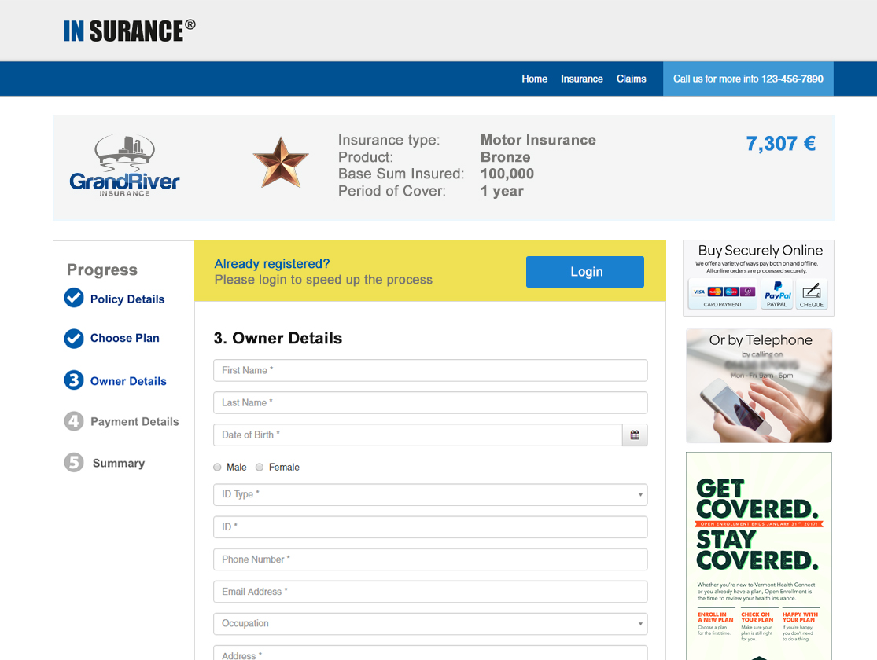
Quote and Sales System with Guided Process Flow

Slide 9




Stand Alone Module 2: Claim
Simple and easy to use solution so claimants can lodge their claims
from wherever they are at the moment
Minimize turnaround time
Reduce infrastructure costs
Increase productivity
Simplify claim document management
Reduce fraudulent claims

Slide 10
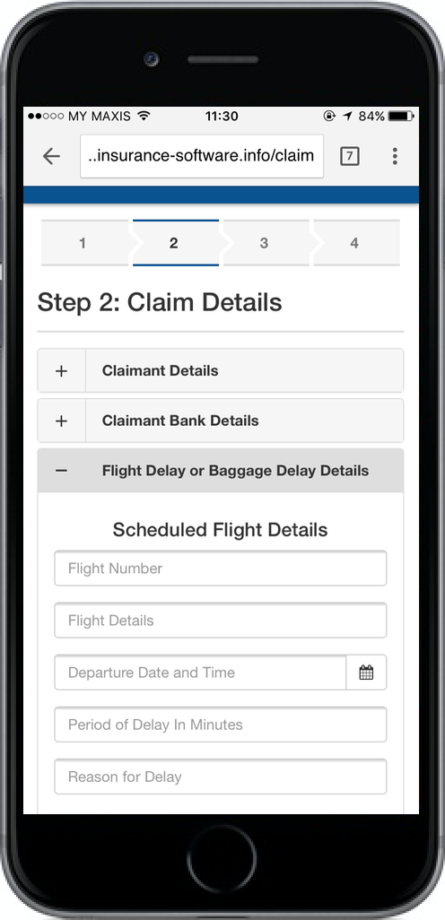
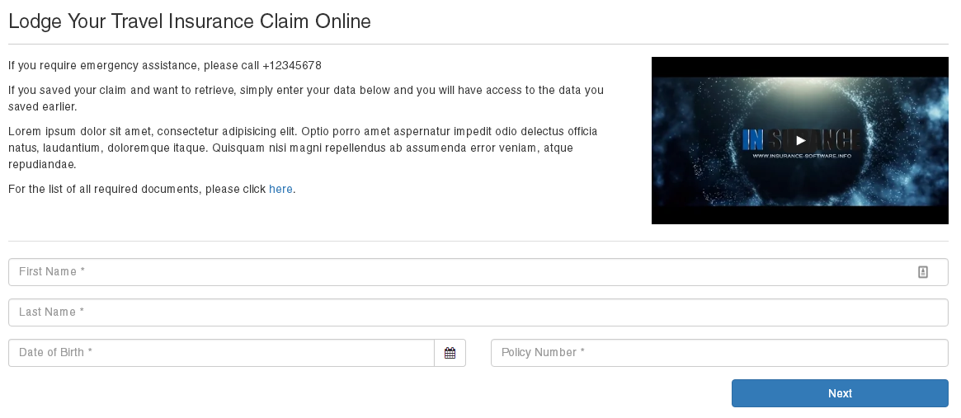
(Mobile) Claim on the Spot

Slide 11



Stand Alone Module 3: Customer Service Portal
Not just a convenience for your clients, but a major boost to your revenues as well
Contributes to Company’s Image
Online Customer Self Service reduces Labor Costs
Increases customer loyalty
valuable Channel to Cross-sell, Up-sell Products
Simplified Policy Endorsement process

Slide 12
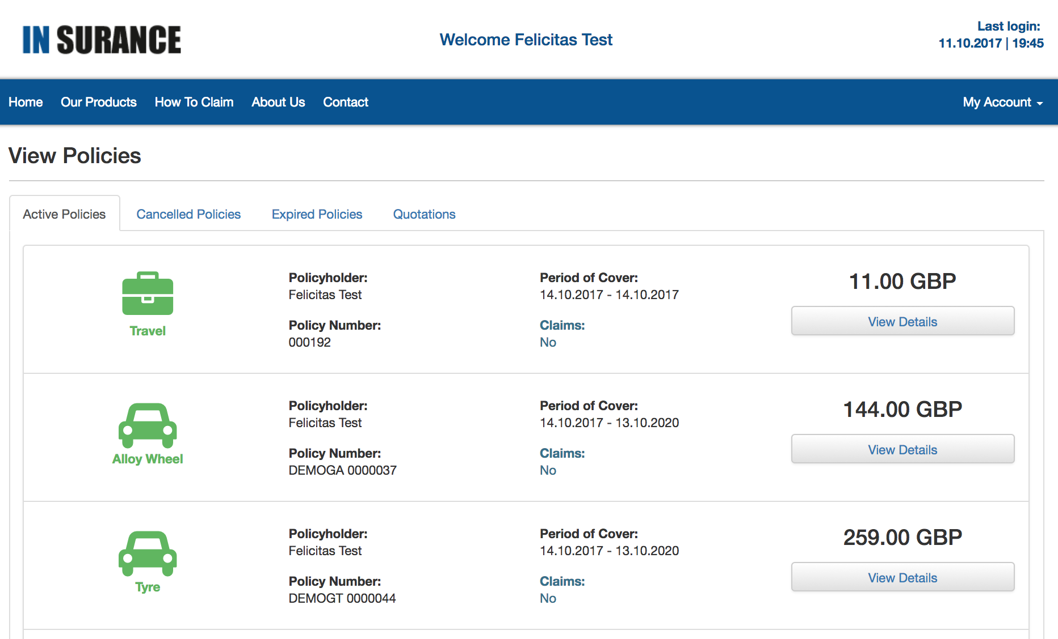
Stand Alone Module 3: Customer Service Portal

Slide 13






Supported Products
Our Rating Engine supports all Insurance Products
Travel
PA
Vehicle
Sport
Health
Liability
Marine
Any many more…

Slide 14





Powerful API: Connecting Everything
Telematics Solutions
Business Intelligence
3rd Party Back Office
Payment Gateways
Big Data Application
Marketing Software, Call Center, GDS System, Booking System and more …....
14

Slide 15








Industry Leading Technology to Ensure Safety
FIREWALL
DATA ENCRYPTION
SSL CERTIFICATE
REGULAR BACKUPS
STRONG PASSWORDS
VIRUS DETECTION
ACTIVITY MONITORING
ACCESS MONITORING

Slide 16
Various Business Concepts (1-3)
Complete IT Setup
Run tigerlab’s INSURANCE Business Suite as your main Insurance IT Infrastructure
Initial Setup for new Insurance Companies
Complete IT replacement of the existing Insurance IT Infrastructure
Partial IT replacement
Replace outdated modules of the existing Insurance IT Infrastructure with our state of the art Stand Alone modules
Quote and Sales Module and/or
Claim Module
Customer Service Portal
Product diversification
Add new Insurance Products to your Product Portfolio by using tigerlab’s Solution

Slide 17
Various Business Concepts (4-5)
Additional Sales Channel
Use tigerlab’s INSURANCE Software to create new Sales Channels for your product
B2C - Product Portal
B2B2C - Agency/Broker Portal
B2E – Employee Insurance Portal
Aggregator Websites
Ancillary Service
Use tigerlab’s INSURANCE API to integrate to 3rd Party E-Commerce Channels in order to upsell Insurance Products, e.g.
Extended Warranty on Gadgets, Spare Parts at any E-Commerce Platform
Event Cancellation Insurance at Event Booking Websites
Travel Insurance at Travel Booking Engines (e.g. Abacus, Amadeus, Sabre, ….)

Slide 18
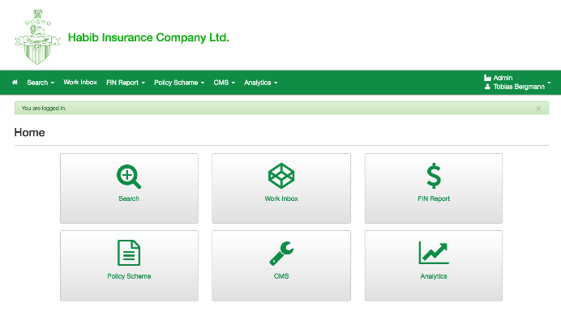

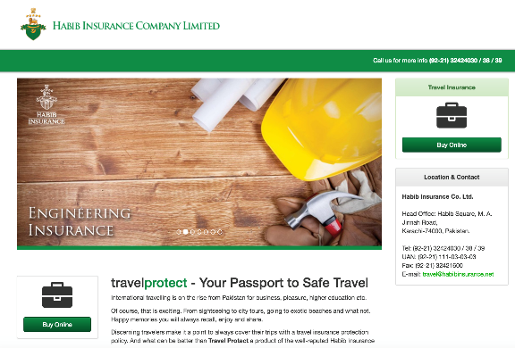

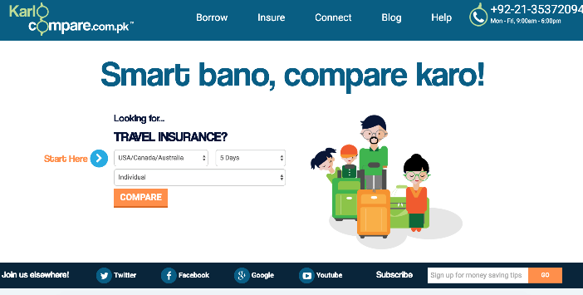
Client Example “Habib Insurance”
Situation before:
Products (6): Fire, Engineering, Marine, Terrorism, Liability, Health
Sales Channel: Bank
Situation After:
Product diversification
Travel
Motor
Additional Sales Channel:
Travel Agencies
Online Portal (B2C)
Aggregator Website

Slide 19


























tigerlab’s INSURANCE software Clients
(RE-) INSURANCE COMPANIES & INTERMEDIARIES

Slide 20
Pricing Models
The Software is priced on the Clients GWP (GROSS WRITTEN PREMIUM). The Percentage is based on the Software scope and expected Volume.
SCOPE, either based on the whole
tigerlab INSURANCE Business Suite
Quote and Sales Module
Claim Submission/Management Module
Customer Service Portal Module
Back Office Solution
or calculated individual on each Module

Slide 21
NO Upfront Costs
NO Installation Cost, which includes all task to Go Live, e.g.
Product Configuration
Pricing Setup
Templates (Certificate, Quotation)
Layout (look and feel)
Process configuration (Views & Fields)
and more
NO Software License fee or User based fee
NO Maintenance / Upgrade Fee

Slide 22
Add On Service Costs
Software hosting
monthly AWS Hosting fees will be charged to client. No additional fees on the AWS administration
Additional Services
Data Migration
3rd Party Integrations (like BI, Telephone System Accounting, …)
Software Requirements, which are specific for Clients need and cant be reused for the Insurance Industry Standards

Slide 23
More Information
Website
Product Website: http://www.insurance-software.info
Company Website: http://www.tigerlab.com/
Product Demo:
B2C Quote and Sales Demo: http://demo52.insurance-software.info
Business Suite Demo: To be provided upon request
Video & More:
Short Product Intro Video (3min): https://youtu.be/9Edn__OpkYA
Screenshot handouts: (click here to download)

Slide 24
various Client Insights
User Based Insurance (UBI)
tigerlab connects to a Client Telematics App to retrieve Data and calculate the monthly Motor Premium
Facebook Messenger including Chat Bots tigerlab have built an integration into Facebook messenger, which uses chat bots to retrieve customer and insured object data for Premium Pricing calculation
Aggregator
tigerlab have built an aggregator/comparison site allowing multi quote insurance on motor, travel, fire and PA.

Slide 25

Customer References
“I We are very satisfied with the software and the expertise in consulting provided by the tigerlab staff and Mr. Bergmann himself. We successfully run this application and you can have a look at https://meine.aok.de/ but its only available for German Customers so it is only in German .”
Tobias Dürr AOK Systems, Germany
“Application does exactly what needs to be done using the latest technology - new features are released on a regular basis. The support is prompt and professional. People behind it are here to grow with you, not just a short-term business. Pricing is significantly below global player level application.”
Daniel Gunawan, Hannover RE
“The team behind tigerlab was from the beginning extremely responsive and we got everything ready and adjusted even before our estimated deadlines. Since then we've never looked back, and are thoroughly enjoying working with their INSURANCE software
Terry WongVLeisure, Vietnam
tigerlab’s Insurance Software is currently the lifeblood of our business and we depend on its accuracy and steady, reliable performance. I can go out to our clients (Insurance Agencies) with certainty, knowing that both software and people behind it won’t let me down.”
Helmi Bin Abdul Rahim, Hong Leong Takaful Malaysia
25

Slide 26


Get in touch
We’ll answer all your questions promptly
Tobias Bergmann (CEO) Kuala Lumpur Office
Stefan Zenk (Head of EMEA) London Office
tobias@tigerlab.com
stefan@tigerlab.com
T.(MY) +60 (0) 196000474
T. (UK) +44 20 8123 0056
26
26

Slide 27
End of main slides
Following are some View Examples and further details to single Product Features

Slide 28
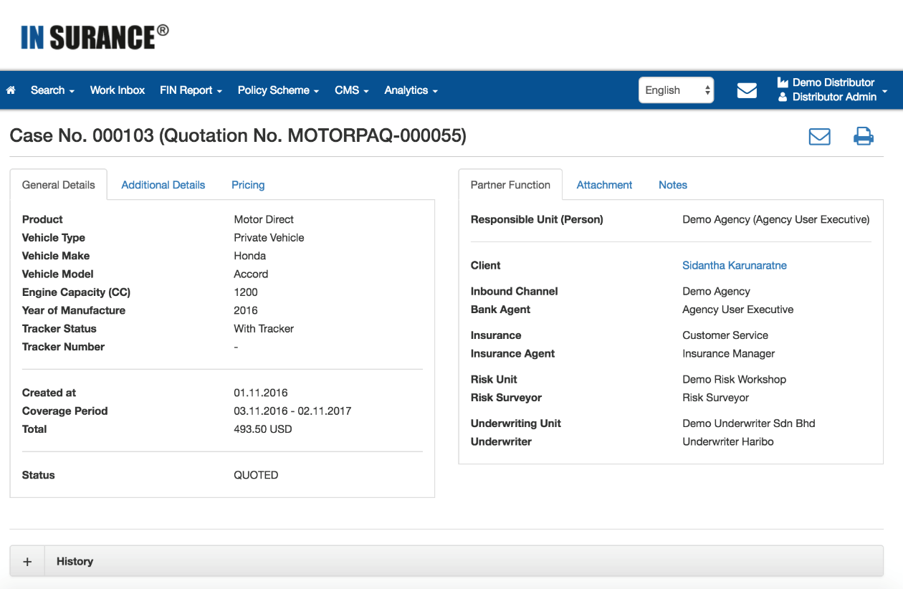
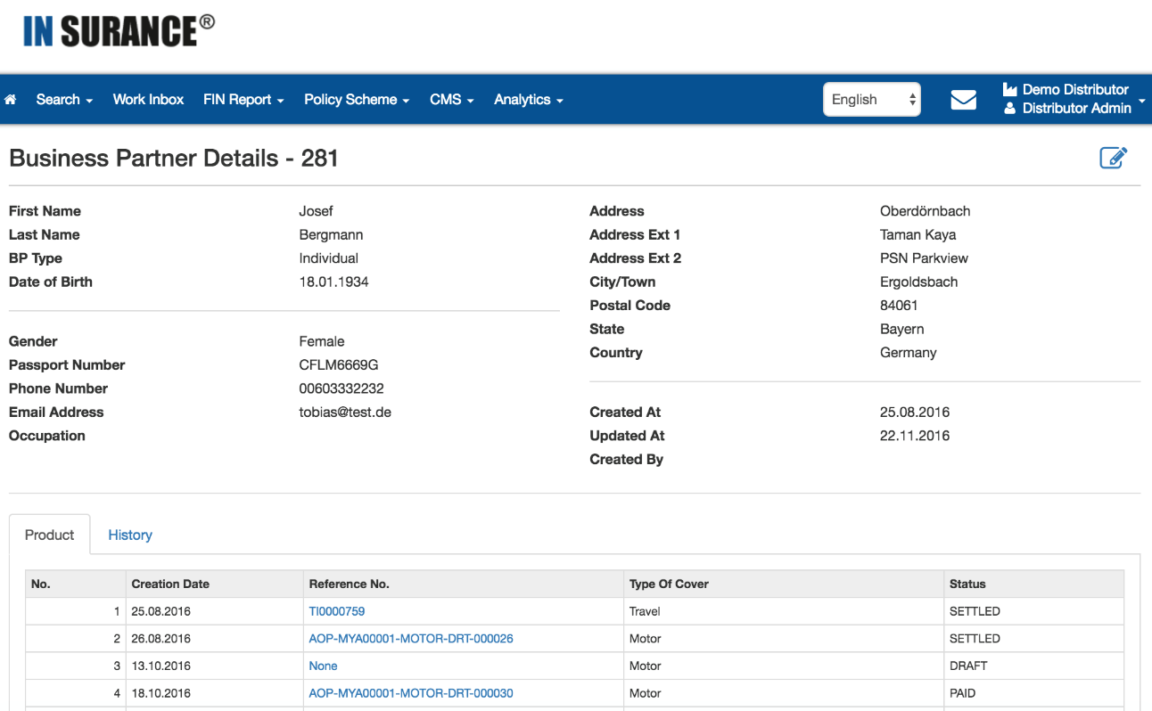
360 Customer, Policy & Claims View
An enhanced 360-degree view is a holistic approach that takes into account all available and meaningful information about the Customer, Policy and Claims
JOIN THE INFORMATION FROM ALL LINES OF YOUR BUSINESS, with just one click and view !


Slide 29
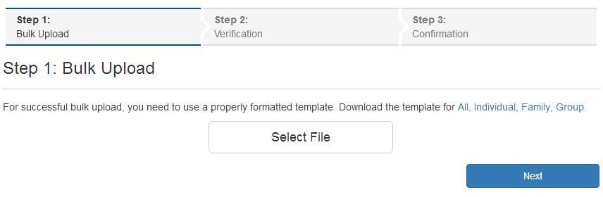
Massive Data Upload Function For Users
Nowadays most of businesses heavily rely on access to Internet. But what happens when for some reason your Agents don’t have access to Internet?
Don’t worry, we have a solution. With our sophisticated Bulk Upload feature, your Agents can maintain all the data in a simple MS Excel sheet. Once they have access to the Internet, they can just upload it and all the policies and quotations are added to the system.


Slide 30
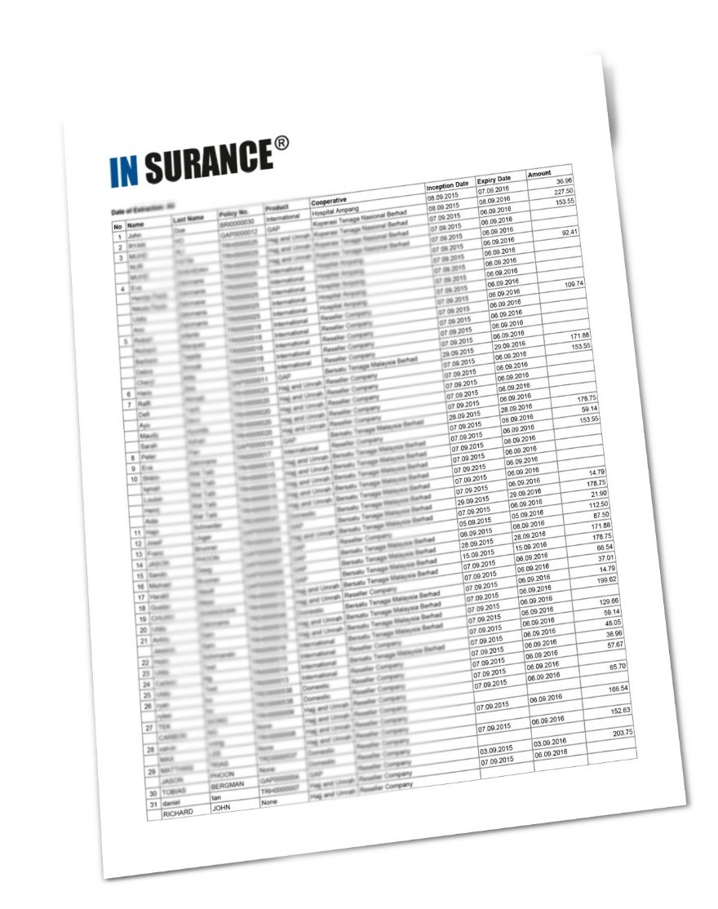
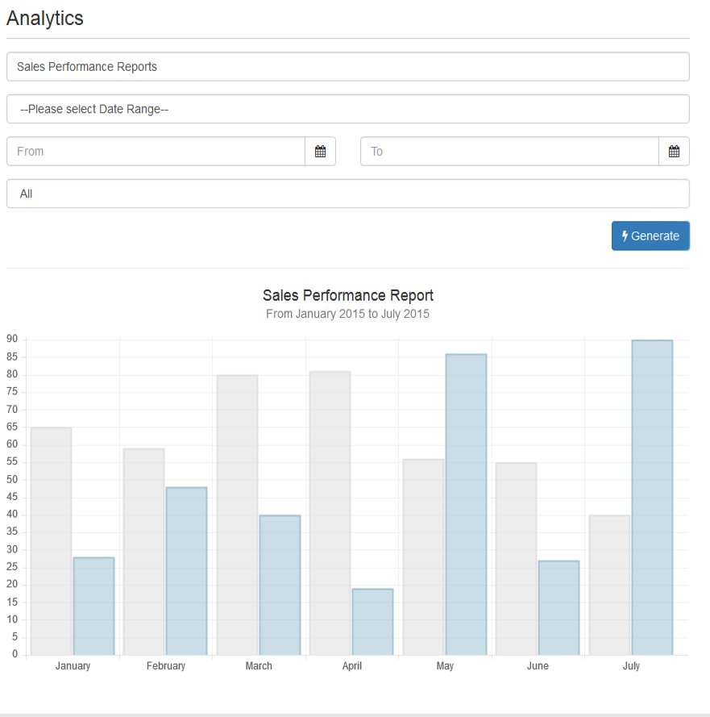
Real-time Reports & Analytics
With the reporting function you will be able to help your bottom line not only by analyzing information about past and present but also predicting the future.
Our highly configurable reporting, analytics and business intelligence module offers insight into your data so you can be proactive and stay on top of the game.


Slide 31
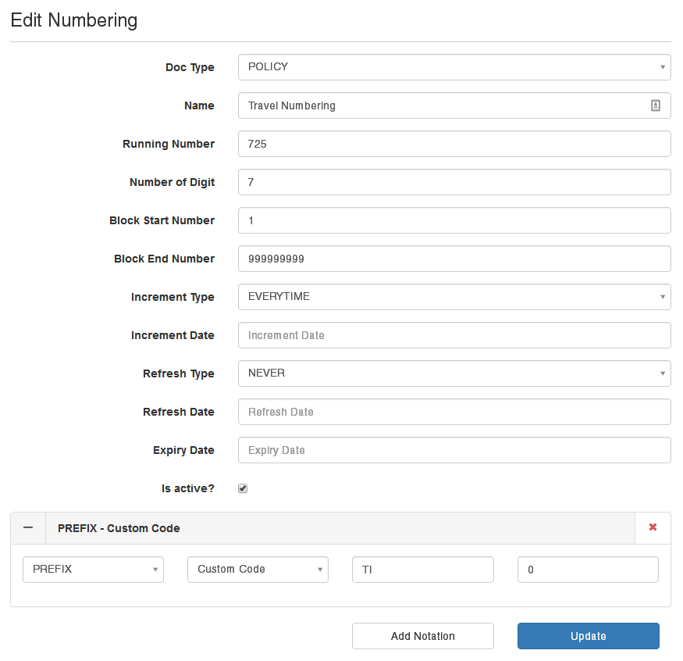
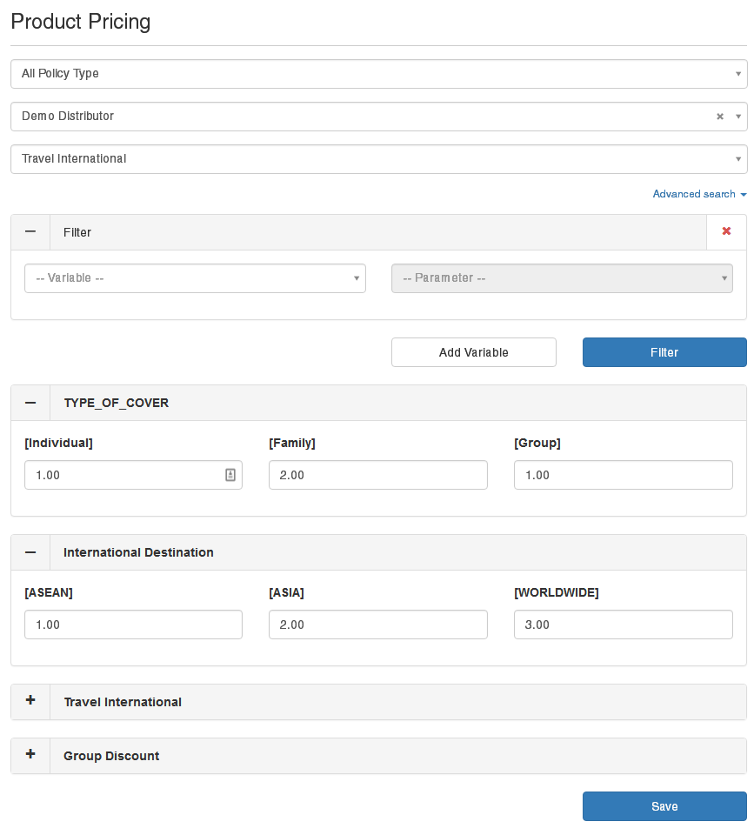
✴
Loads of Configurable Elements
Features, Views, Fields, Products, Plans, Permissions, Business Rules, Content and more can be easily configured, customized and created from your administration console without writing a single line of code. If the feature doesn’t exist in our current version, it will be ready in our next. Our development team loves creative challenges!

Slide 32
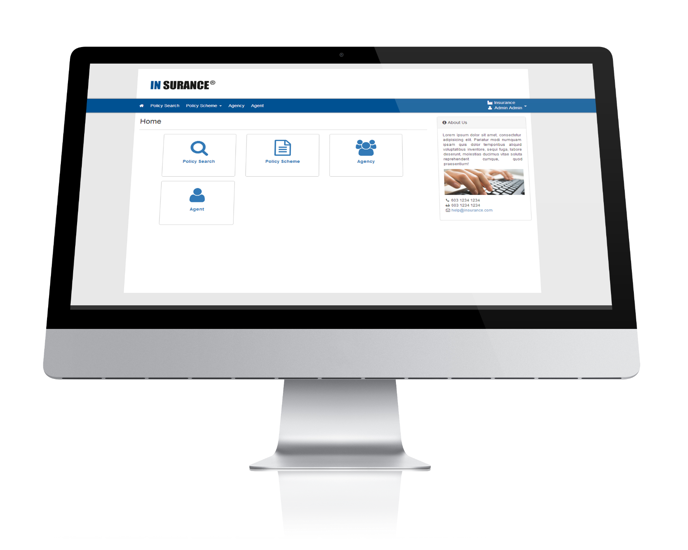
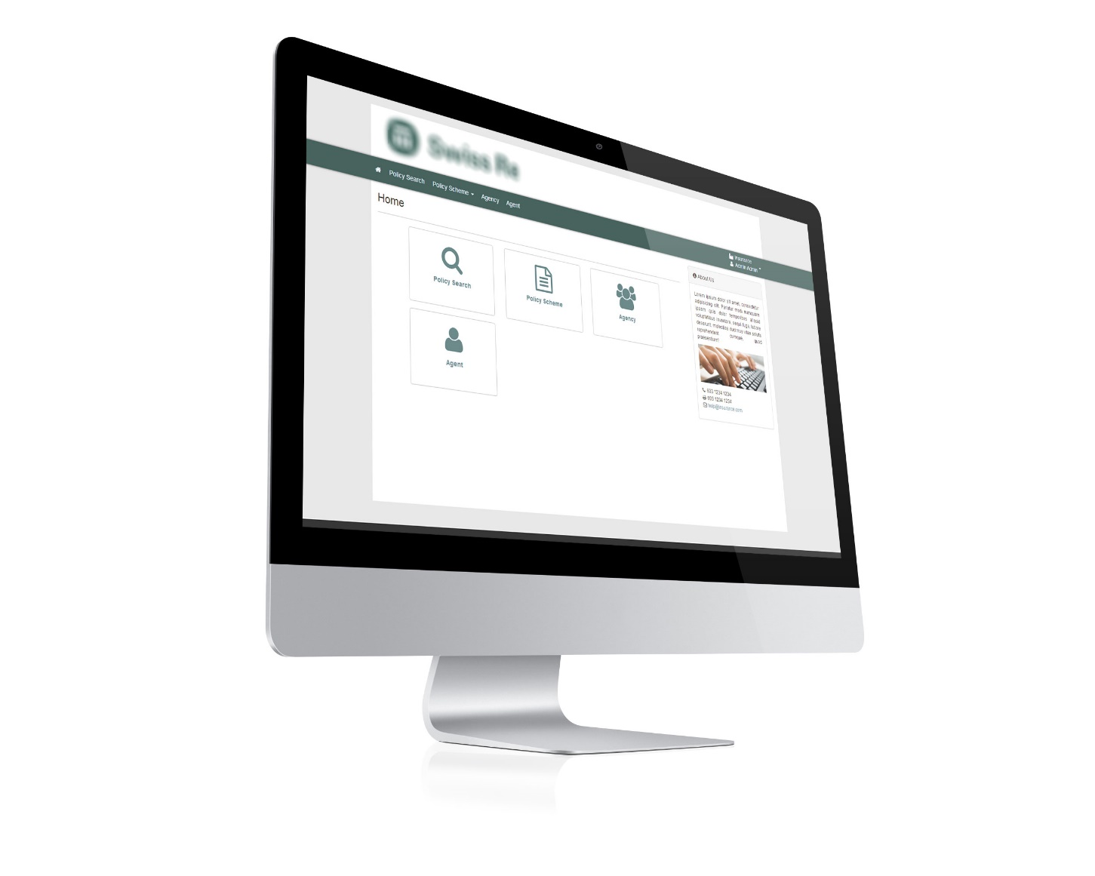
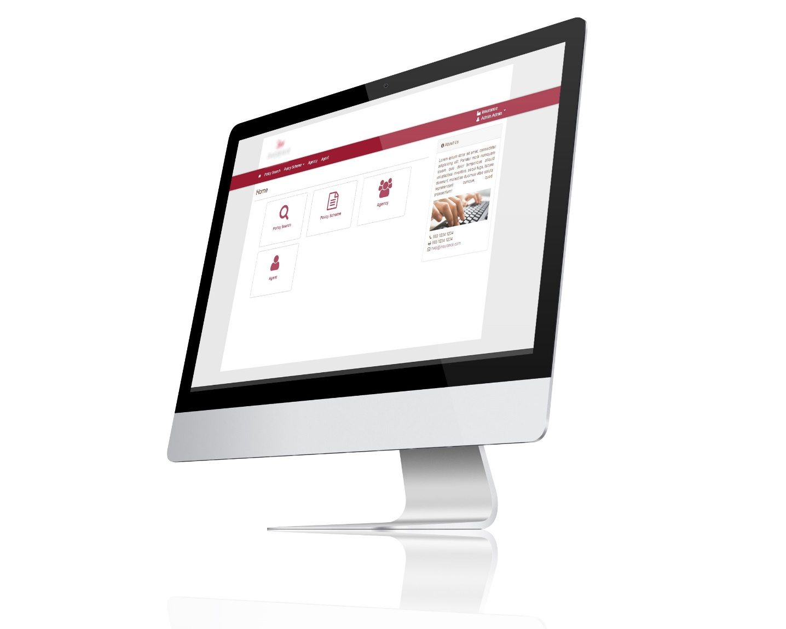
White Label Solution - Feels Like Home
It’s not about tigerlab’s INSURANCE software. IT IS ABOUT YOU AND YOUR COMPANY.
Your application your way – all visible elements align with your corporate style.


Slide 33




Operation System = Linux (Preferred) / Windows
Database = MySQL on local or RDS
Programming Language = python
Framework = django
Basic technical Details



Slide 34









Python – Modern and Reliable Technology
Just like some of the world’s most popular web applications such as Google, Youtube, Instagram and Pinterest to name a few, tigerlab’s INSURANCE application is written in Python.
YOU’RE IN A GOOD COMPANY

34

Slide 35
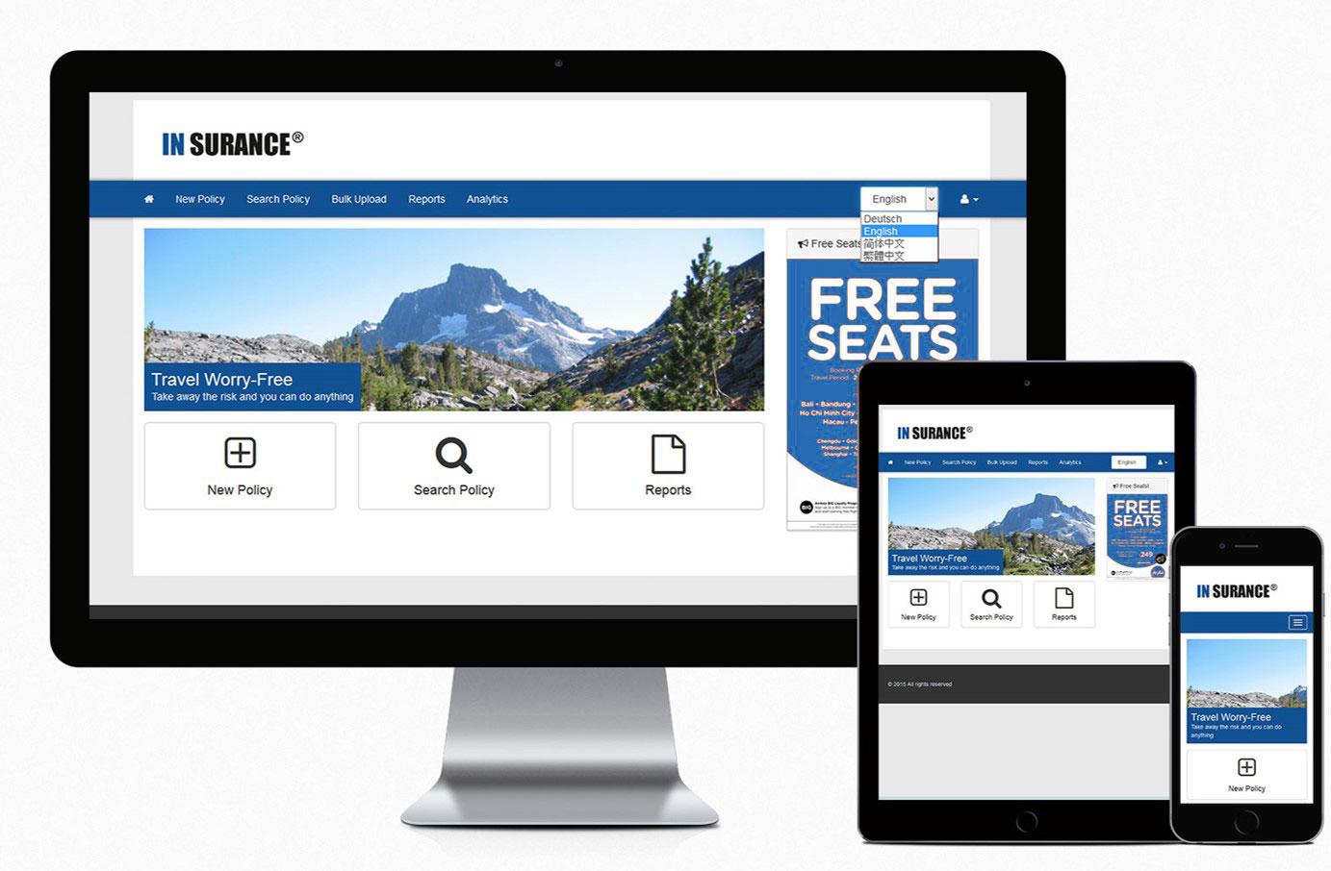

Multiple Device Friendly
Mobile Internet usage has surpassed desktop Internet usage already in 2015. In fact, 80% of Internet users own a Smartphone and use it to access the Internet.
97% of our interfaces adopt to your screen resolution and provide you both mouse and finger friendly environment.

Slide 36

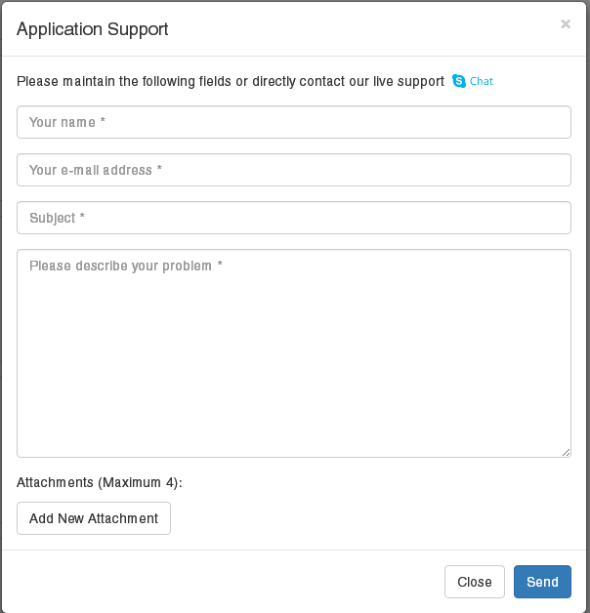
24/7 Support

Our team won’t leave you hanging. You need help? We’re here to help you.

